Slide 1

The Machine Learning Project Lifecycle
Data
Process
Model
Deploy

Slide 2






Data Collection
EDA & Preprocessing & Feature Engineering & Imbalance Handling
Modeling & Evaluation
Deployment
Sources of Data
Files
Key Checks Before Use
Encoding
Verify file encoding (utf-8, latin1, etc.)
CSV, TSV, Excel, and other structured formats
Databases
SQL via SQLAlchemy, pyodbc, psycopg2
APIs
Using requests, pandas.read_json, etc.
Big Data
Spark, Dask for distributed processing
Cloud Storage
AWS S3, Google Cloud Storage, Azure Blob
Delimiters
Check for proper separators (comma, tab, etc.)
df = pd.read_csv("data.csv", delimiter=",")
Large Files
Process in chunks or use distributed tools
for chunk in pd.read_csv("large.csv", chunksize=10000):
Optimize Memory
Convert types and downcast for efficiency
df["category"] = df["category"].astype("category")

Slide 3
Data Collection
EDA & Preprocessing & Feature Engineering & Imbalance Handling
Modeling & Evaluation
Deployment
Data Quality
Correlation Analysis
Splitting
Encoding
Scaling / Transformations
Missing Values
Duplicates
Exploratory Data Analysis
Outliers
Noise
For Categorical/ Numerical/ Datetime/ Time Series/ Text/ Image
Feature Extraction
Feature Selection & DR
Imbalance Handling

Slide 4

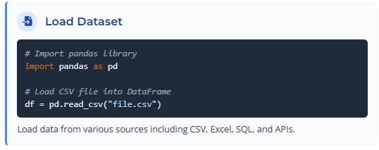
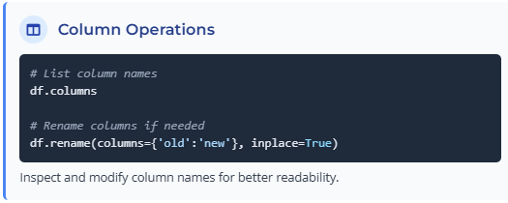
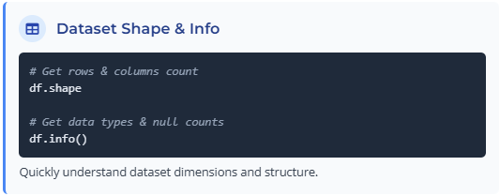
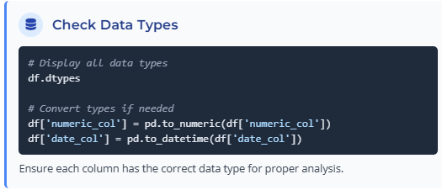
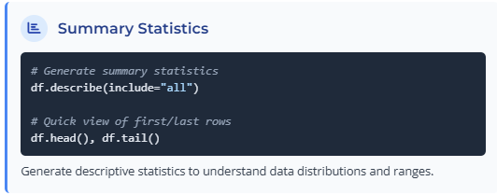
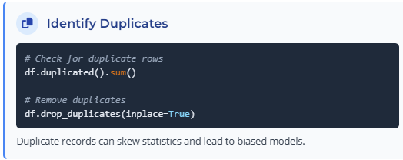
Data Collection
EDA & Preprocessing & Feature Engineering & Imbalance Handling
Modeling & Evaluation
Deployment
Exploratory Data Analysis

Slide 5
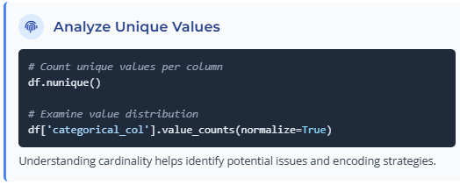
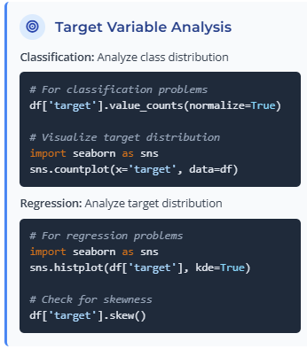
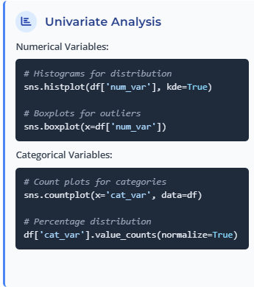
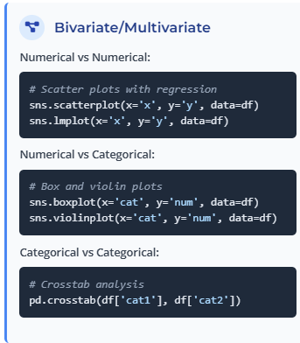
Data Collection
EDA & Preprocessing & Feature Engineering & Imbalance Handling
Modeling & Evaluation
Deployment
For more plots details:
From Data to Viz
Data Viz Project
The Data Visualisation Catalogue
Exploratory Data Analysis

Slide 6
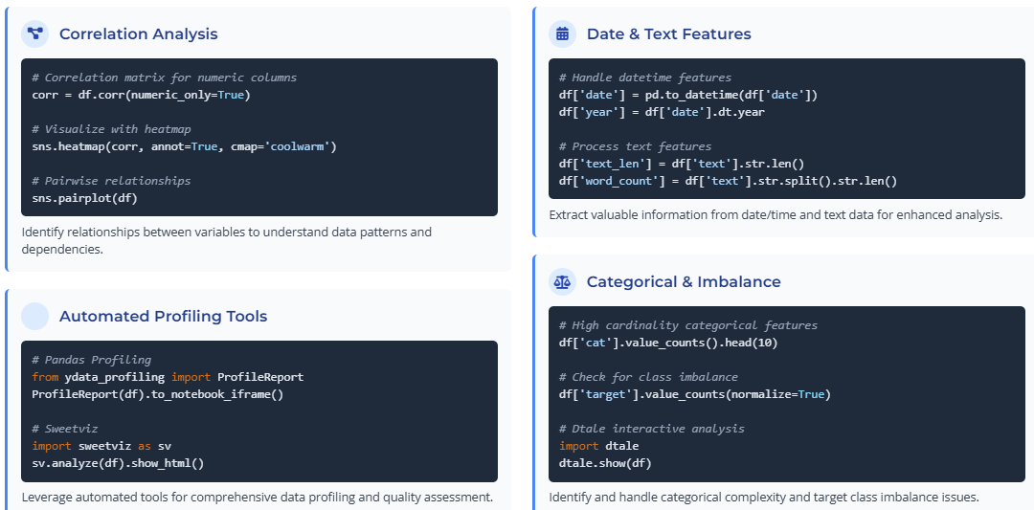
Data Collection
EDA & Preprocessing & Feature Engineering & Imbalance Handling
Modeling & Evaluation
Deployment
Exploratory Data Analysis

Slide 7

Data Collection
EDA & Preprocessing & Feature Engineering & Imbalance Handling
Modeling & Evaluation
Deployment
Missing Values
Detection Methods
Identify missing values in your dataset
df.isnull().sum() # Count missing values per column import missingno as msno
msno.matrix(df) # Visual representation
Important Considerations
Column importance for target/business
Dataset size (avoid dropping with small data)
These percentages are guidelines, not strict rules
Data Quality
missing
Missing % | Few Columns | Many Columns
<10% | Fill | Fill
10-20% | Fill | Fill/Drop
>50% | Drop | Drop
10%
20%
50%
in most of the time
Definitely
filling
Drop
filling
Drop
The data has few columns.
The data has many columns.

Slide 8
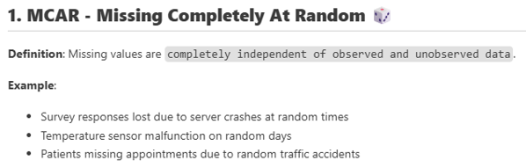
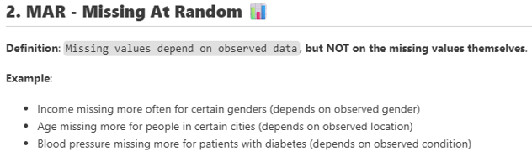

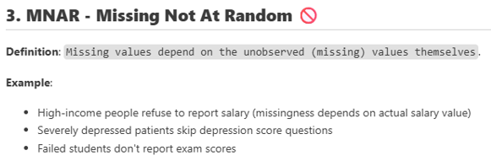
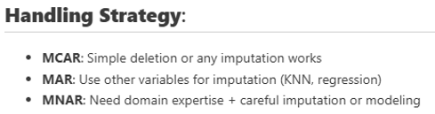
Data Collection
EDA & Preprocessing & Feature Engineering & Imbalance Handling
Modeling & Evaluation
Deployment
Missing data types:
Data Quality

Slide 9
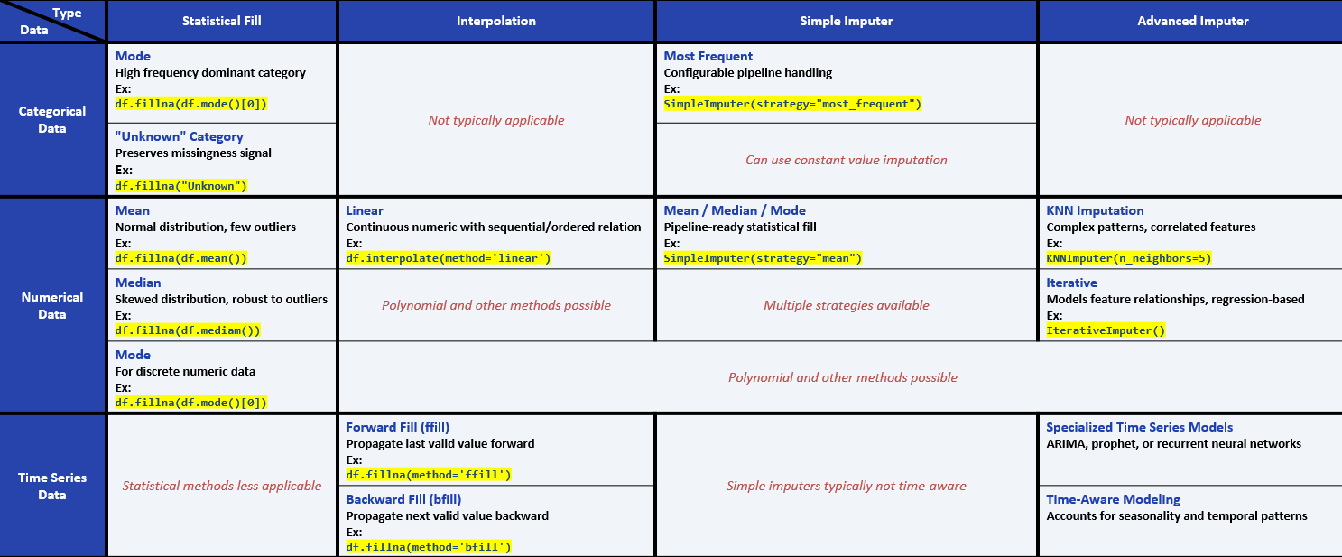
Data Collection
EDA & Preprocessing & Feature Engineering & Imbalance Handling
Modeling & Evaluation
Deployment
Filling:
Statistical approaches [mean, median ,mode]
Interpolation ‘when features are Independent’
Imputer[mean, median ,mode, Modeling like KNN | iterative]
Data Quality

Slide 10
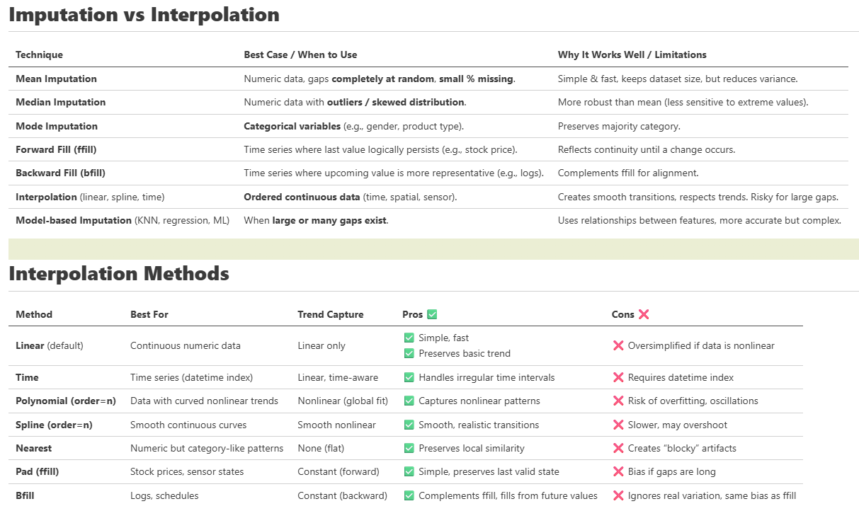
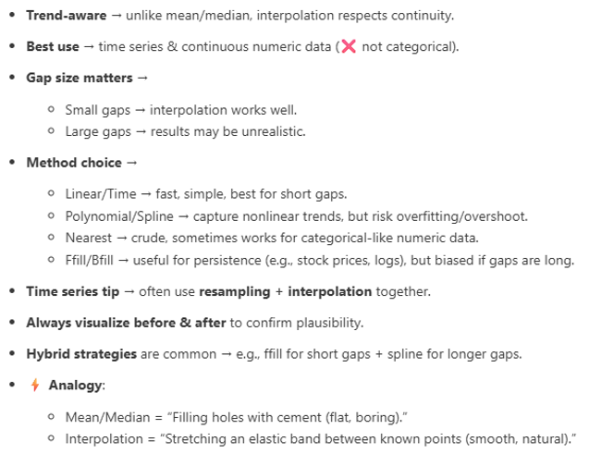
Data Collection
EDA & Preprocessing & Feature Engineering & Imbalance Handling
Modeling & Evaluation
Deployment
Interpolation in details:
Data Quality

Slide 11

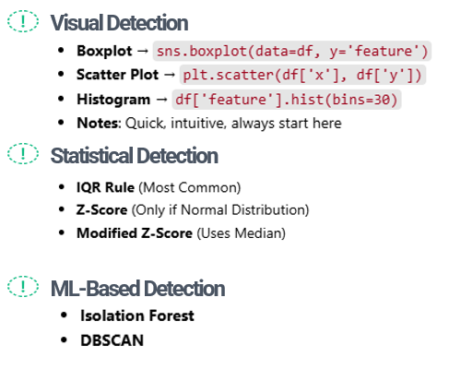
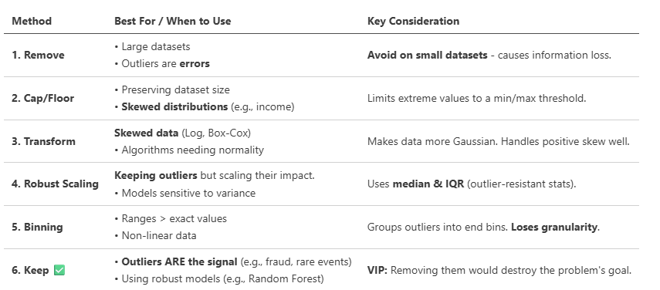
Data Collection
EDA & Preprocessing & Feature Engineering & Imbalance Handling
Modeling & Evaluation
Deployment
Outliers
Detection Methods
Treatment Options
Data Quality

Slide 12
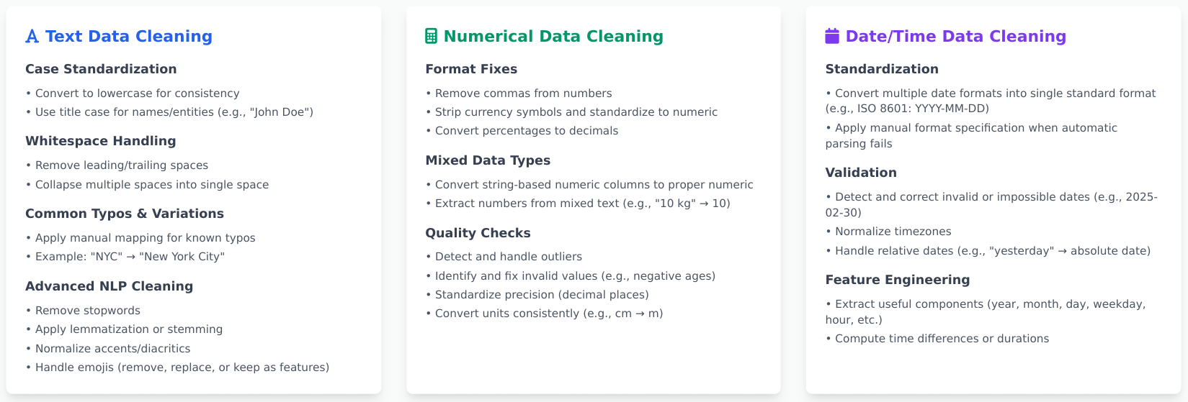
Data Collection
EDA & Preprocessing & Feature Engineering & Imbalance Handling
Modeling & Evaluation
Deployment
Noise
Data Quality

Slide 13
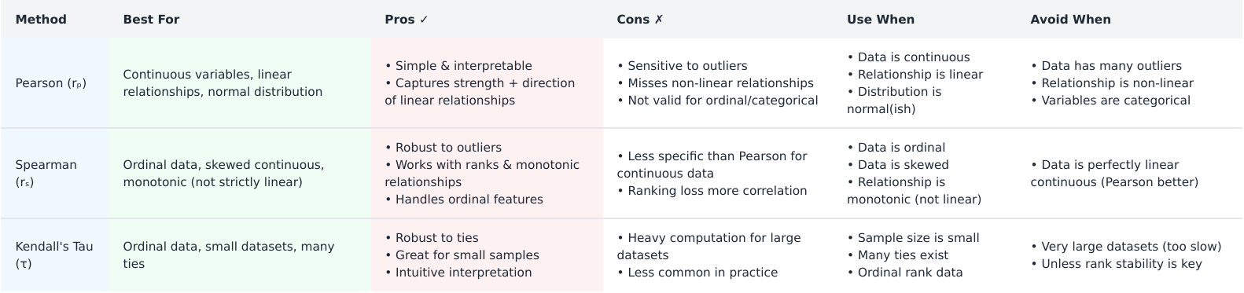
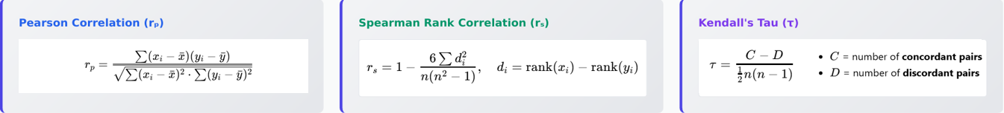
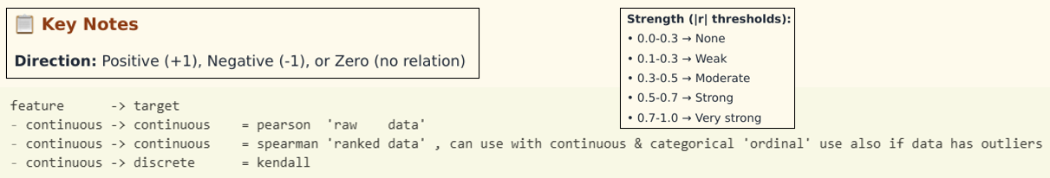
Data Collection
EDA & Preprocessing & Feature Engineering & Imbalance Handling
Modeling & Evaluation
Deployment
Correlation Analysis

Slide 14
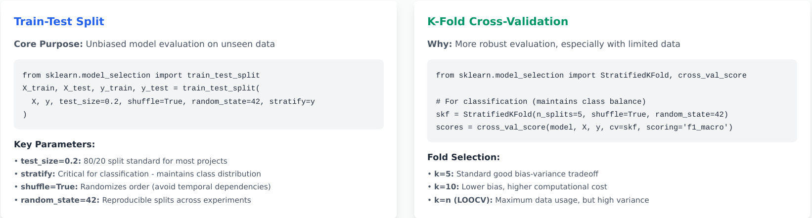
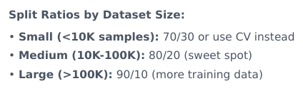
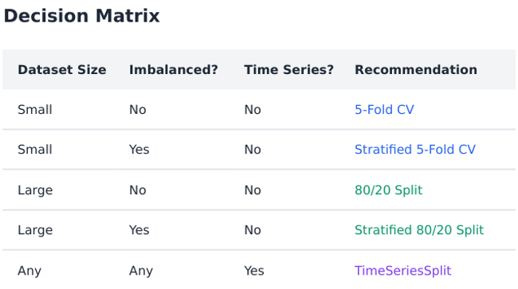
Data Collection
EDA & Preprocessing & Feature Engineering & Imbalance Handling
Modeling & Evaluation
Deployment
Splitting

Slide 15
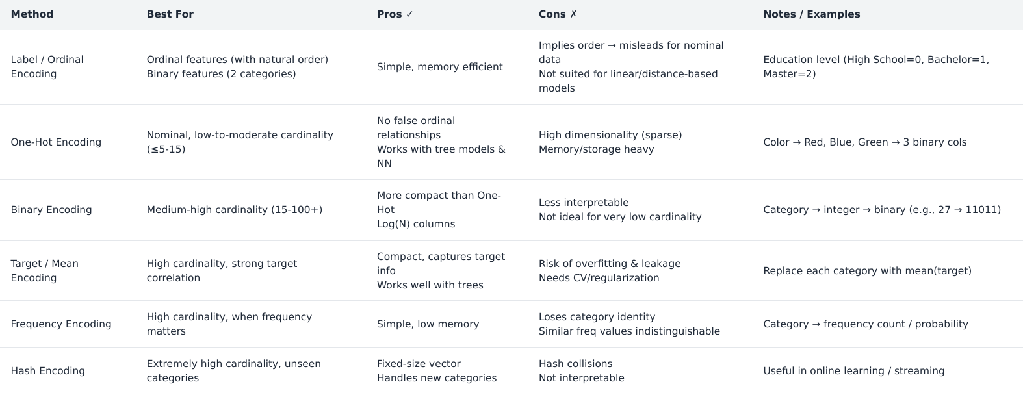
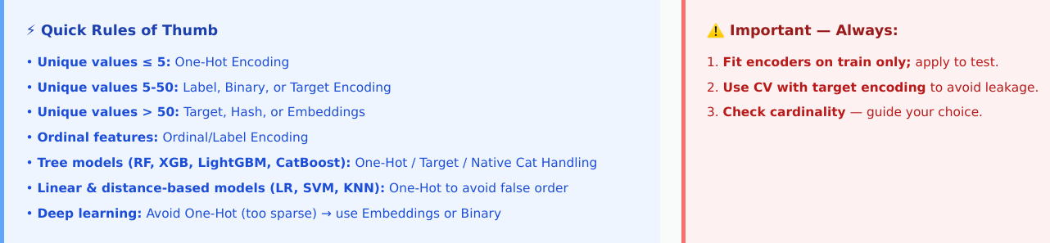
Data Collection
EDA & Preprocessing & Feature Engineering & Imbalance Handling
Modeling & Evaluation
Deployment
Encoding

Slide 16
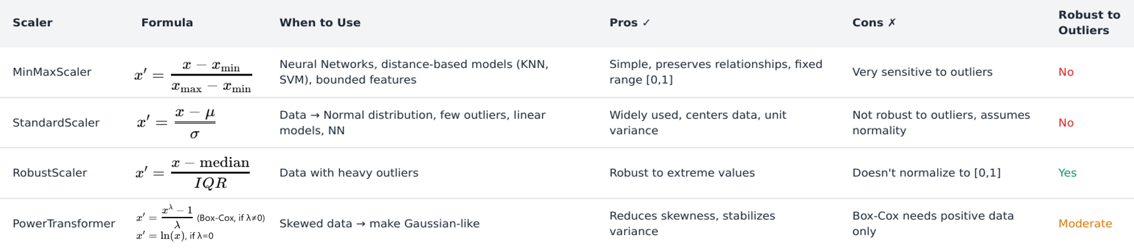
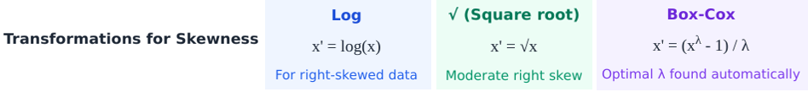
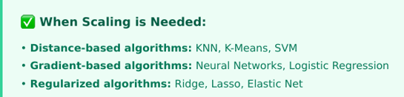
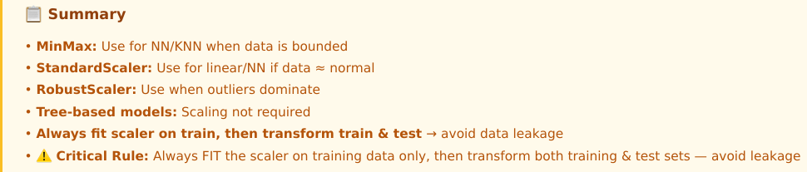
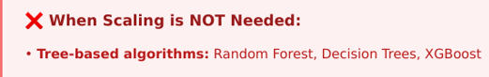
Data Collection
EDA & Preprocessing & Feature Engineering & Imbalance Handling
Modeling & Evaluation
Deployment
Scaling / Transformations

Slide 17
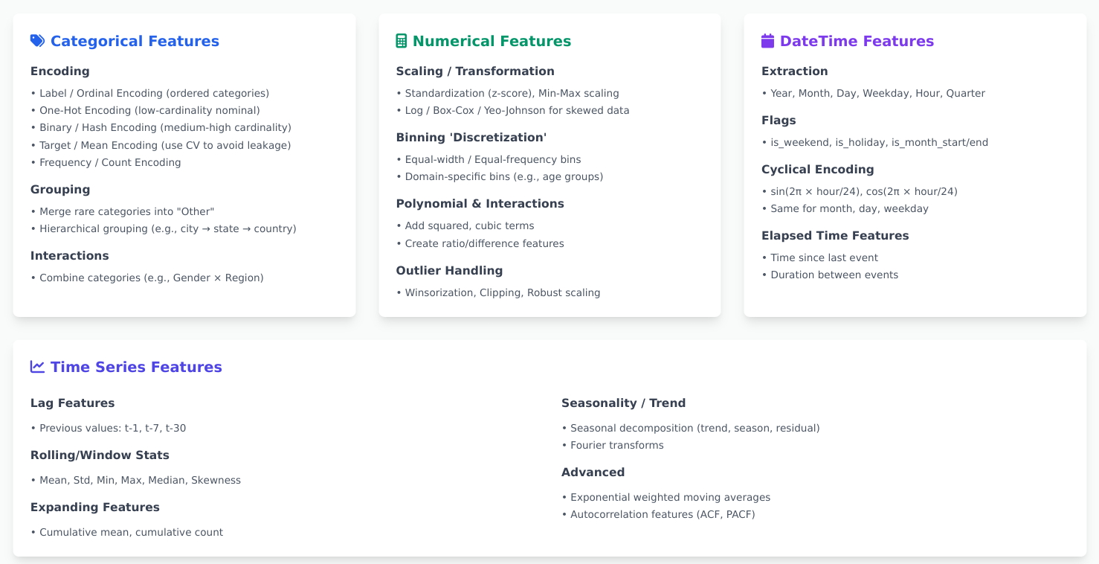
Data Collection
EDA & Preprocessing & Feature Engineering & Imbalance Handling
Modeling & Evaluation
Deployment
For Categorical/ Numerical/ Datetime/ Time Series/ Text/ Image

Slide 18
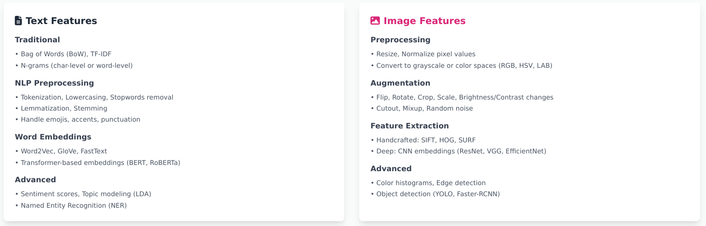
Data Collection
EDA & Preprocessing & Feature Engineering & Imbalance Handling
Modeling & Evaluation
Deployment
For Categorical/ Numerical/ Datetime/ Time Series/ Text/ Image

Slide 19
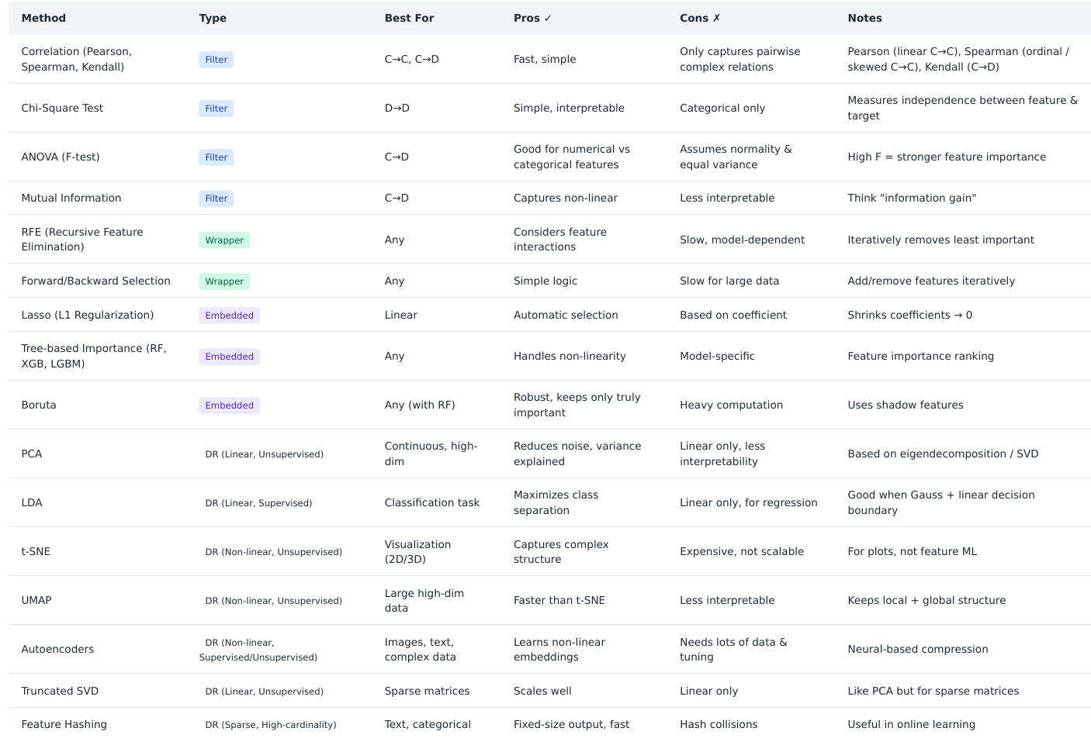
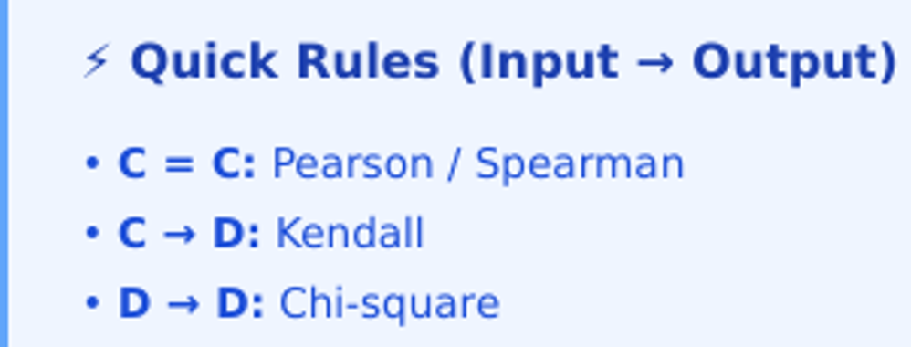
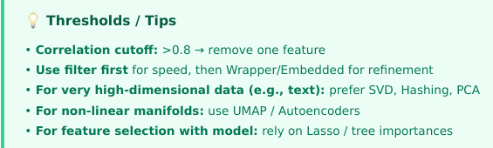
Data Collection
EDA & Preprocessing & Feature Engineering & Imbalance Handling
Modeling & Evaluation
Deployment
Feature Selection & DR

Slide 20
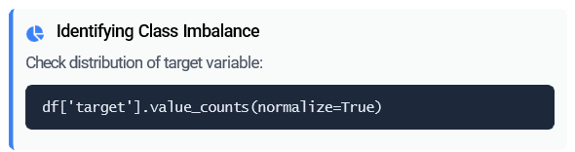
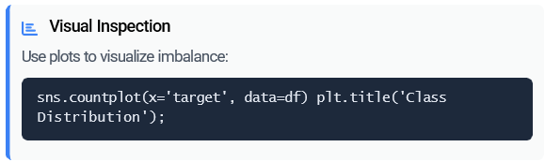

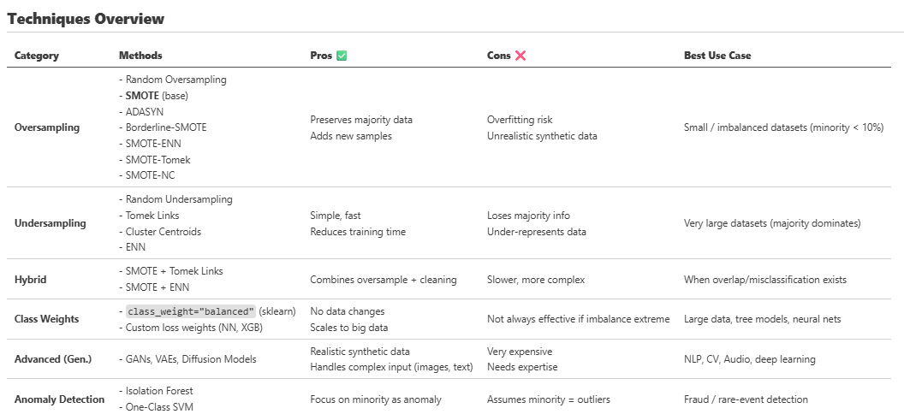
Data Collection
EDA & Preprocessing & Feature Engineering & Imbalance Handling
Modeling & Evaluation
Deployment
Detection & Analysis
Imbalance Handling

Slide 21
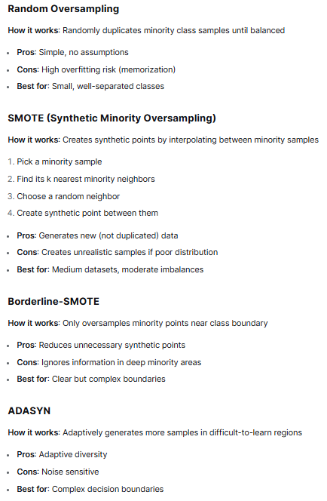
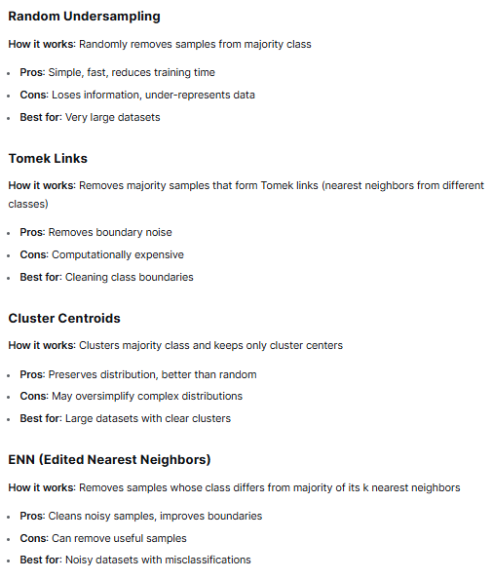
Data Collection
EDA & Preprocessing & Feature Engineering & Imbalance Handling
Modeling & Evaluation
Deployment
Imbalance Handling
Oversampling Techniques
Undersampling Techniques

Slide 22
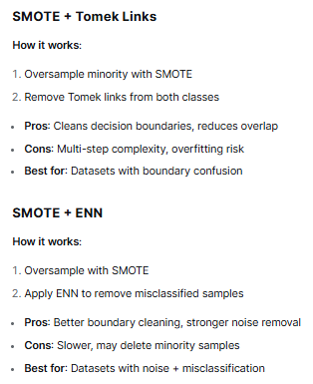
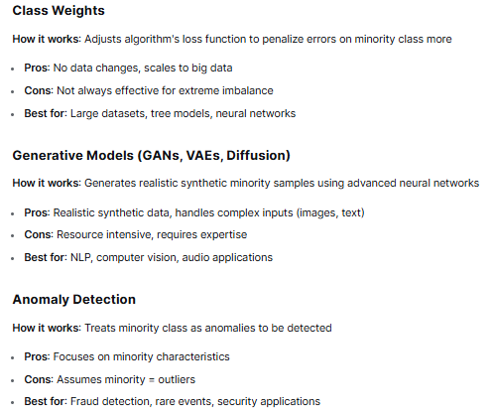
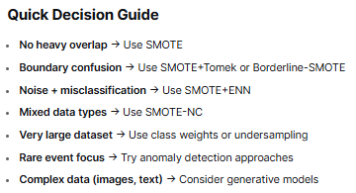
Data Collection
EDA & Preprocessing & Feature Engineering & Imbalance Handling
Modeling & Evaluation
Deployment
Imbalance Handling
Advanced Techniques
Hybrid Approaches

Slide 23
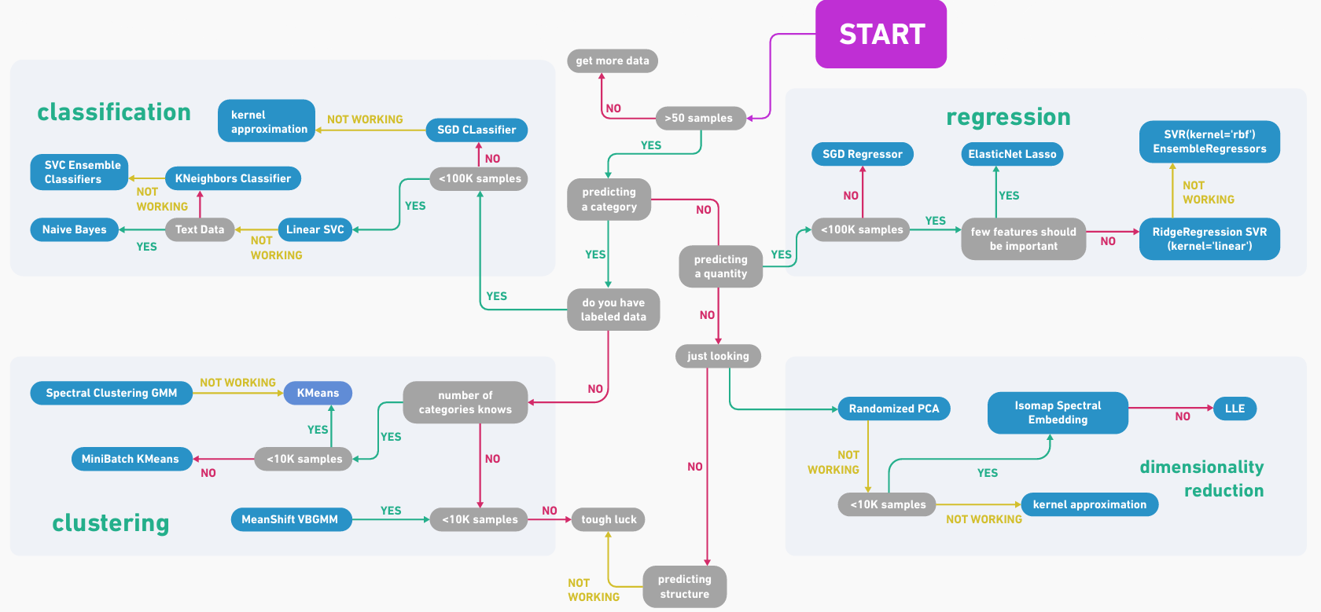
Data Collection
EDA & Preprocessing & Feature Engineering & Imbalance Handling
Modeling & Evaluation
Deployment

Slide 24
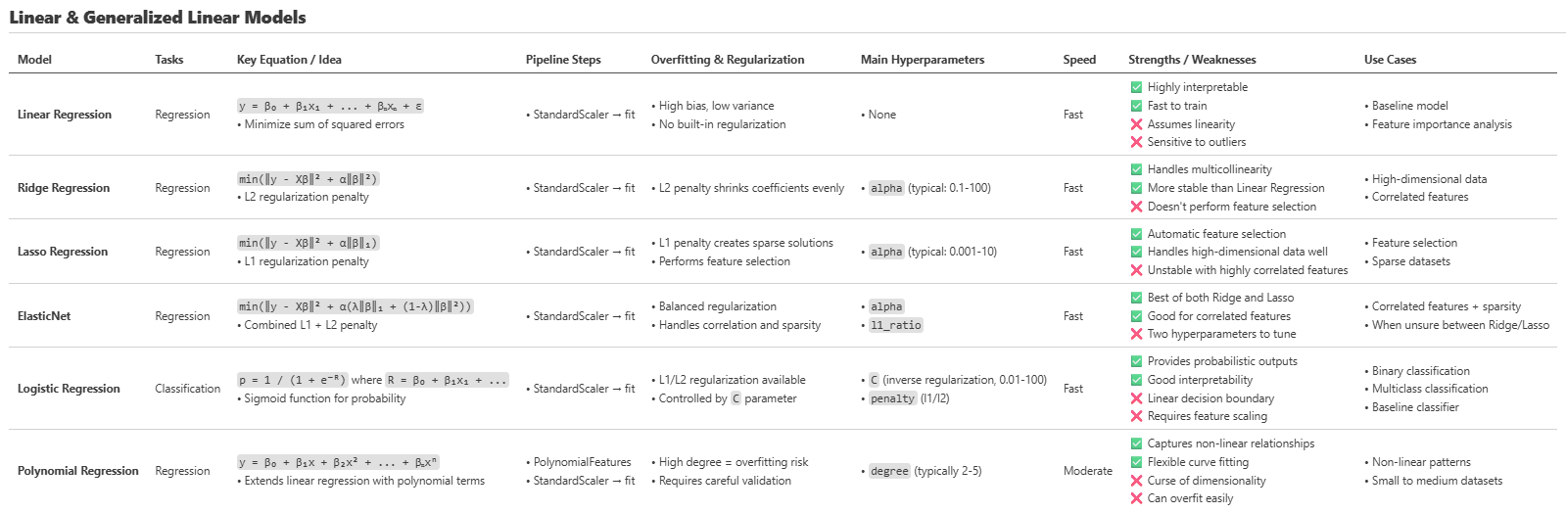
Data Collection
EDA & Preprocessing & Feature Engineering & Imbalance Handling
Modeling & Evaluation
Deployment

Slide 25
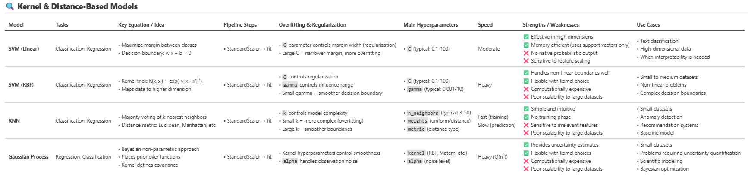

Data Collection
EDA & Preprocessing & Feature Engineering & Imbalance Handling
Modeling & Evaluation
Deployment

Slide 26

Data Collection
EDA & Preprocessing & Feature Engineering & Imbalance Handling
Modeling & Evaluation
Deployment

Slide 27


Data Collection
EDA & Preprocessing & Feature Engineering & Imbalance Handling
Modeling & Evaluation
Deployment

Slide 28




Data Collection
EDA & Preprocessing & Feature Engineering & Imbalance Handling
Modeling & Evaluation
Deployment

Slide 29


Data Collection
EDA & Preprocessing & Feature Engineering & Imbalance Handling
Modeling & Evaluation
Deployment

Slide 30


Data Collection
EDA & Preprocessing & Feature Engineering & Imbalance Handling
Modeling & Evaluation
Deployment

Slide 31



Data Collection
EDA & Preprocessing & Feature Engineering & Imbalance Handling
Modeling & Evaluation
Deployment

Slide 32


Data Collection
EDA & Preprocessing & Feature Engineering & Imbalance Handling
Modeling & Evaluation
Deployment

Slide 33



So, in Summary

Slide 34



Notes
End
🫡

